Slide 1

8th Grade Math: Pre-Algebra
Unit 3, Lesson 2 Writing Large Numbers Using Scientific Notation Volume 1, pg. 86

Slide 2


Benchmark
MA.8.NSO.1.4
Express numbers in scientific notation to represent and approximate very large or very small quantities. Determine how many times larger or smaller one number is compared to a second number.
volume 1, pg. 86

Slide 3
Integrated Mathematical Thinking and Reasoning Standards
MA.K12.MTR.1.1 Actively participate in effortful learning both individually and collectively.
MA.K12.MTR.2.1 Demonstrate understanding by representing problems in multiple ways.
MA.K12.MTR.3.1 Complete tasks with mathematical fluency.
MA.K12.MTR.4.1 Engage in discussions that reflect on the mathematical thinking of self and others.
MA.K12.MTR.5.1 Use patterns and structure to help understand and connect mathematical concepts.
MA.K12.MTR.7.1 Apply mathematics to real-world contexts.
volume 1, pg. 86

Slide 4

Learning Targets
I can express large numbers using scientific notation.
I can determine how many times larger or smaller a number is compared to another expressed in scientific notation.
volume 1, pg. 86

Slide 5

Warm-Up
volume 1, pg. 86

Slide 6
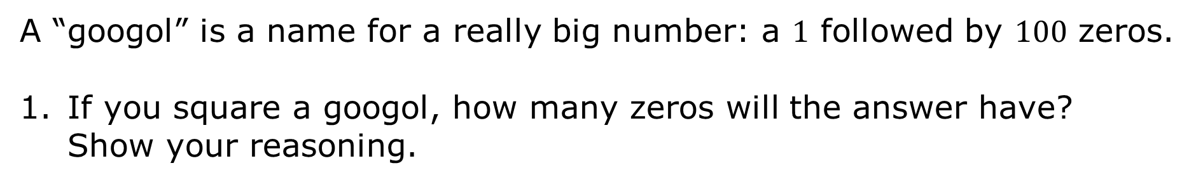
3.2.1 Warm-Up: Googol, not Google
A “googol” is a name for a really big number: a $1$ followed by $100$ zeros.
If you square a googol, how many zeros will the answer have? Show your reasoning.
volume 1, pg. 86
Notes:
Video Link: https://algebranation.wistia.com/medias/fi4fidi5y8

Slide 7

Exploration
volume 1, pg. 87

Slide 8
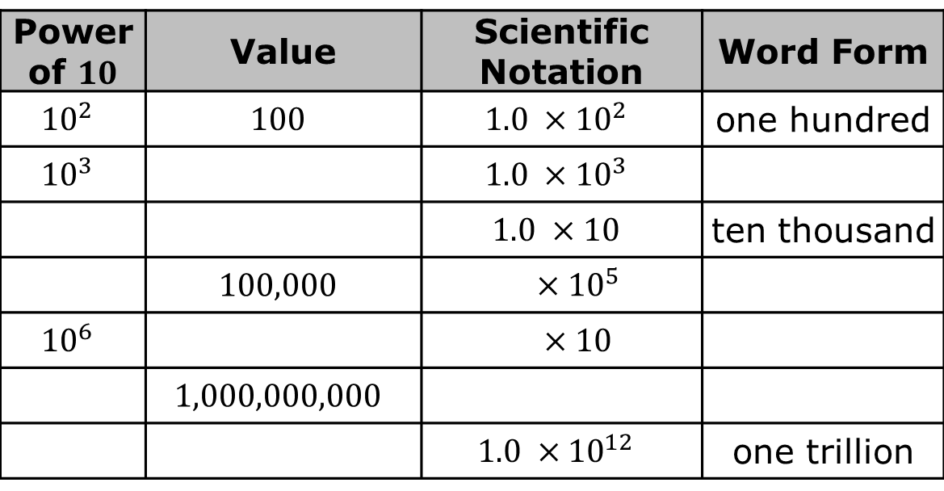
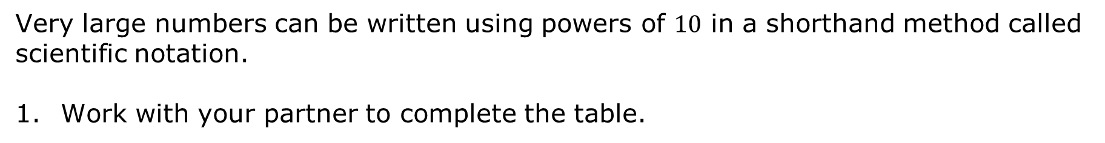
3.2.2 Exploration: Patterns in Scientific Notation
Very large numbers can be written using powers of $10$ in a shorthand method called scientific notation.
Work with your partner to complete the table.
Power of $10$ | Value | Scientific Notation | Word Form
$${10}^{2}$$ | $$100$$ | $$1.0 ×{10}^{2}$$ | one hundred
$${10}^{3}$$ |  | $$1.0 ×{10}^{3}$$
 |  | $$1.0 ×10$$ | ten thousand
 | $$100,000$$ | $$×{10}^{5}$$
$${10}^{6}$$ |  | $$×10$$
 | $$1,000,000,000$$
 |  | $$1.0 ×{10}^{12}$$ | one trillion
volume 1, pg. 87

Slide 9
Select two of the numbers. Work with your partner to name something in the world that is described by those numbers.
Number | What can be described by this number in the real world?
volume 1, pg. 87

Slide 10
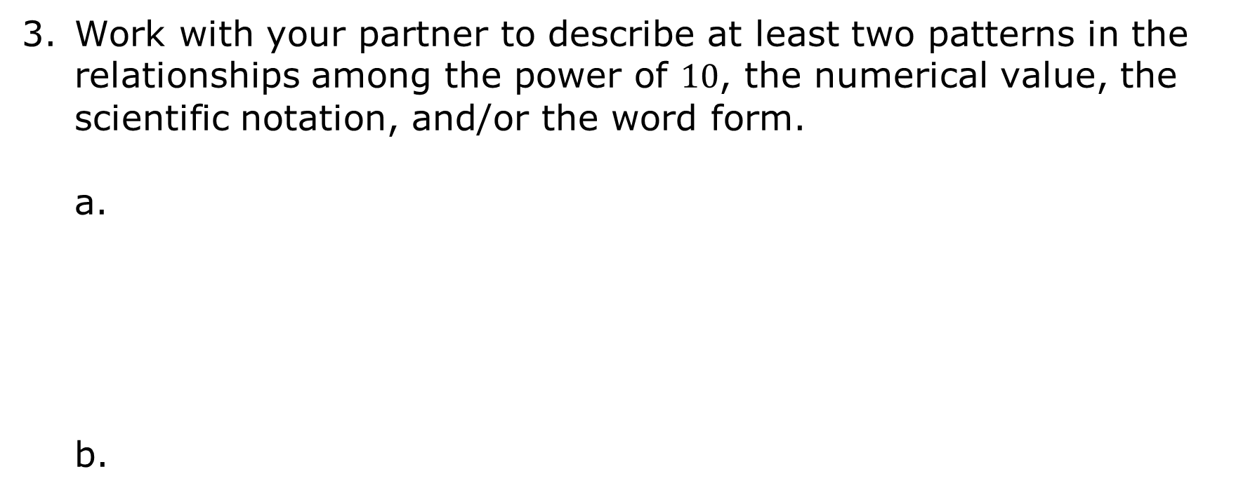
Work with your partner to describe at least two patterns in the relationships among the power of $10$, the numerical value, the scientific notation, and/or the word form.
volume 1, pg. 87

Slide 11

Guided Instruction
volume 1, pg. 88

Slide 12

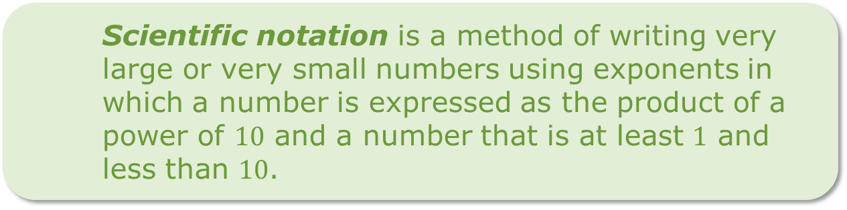
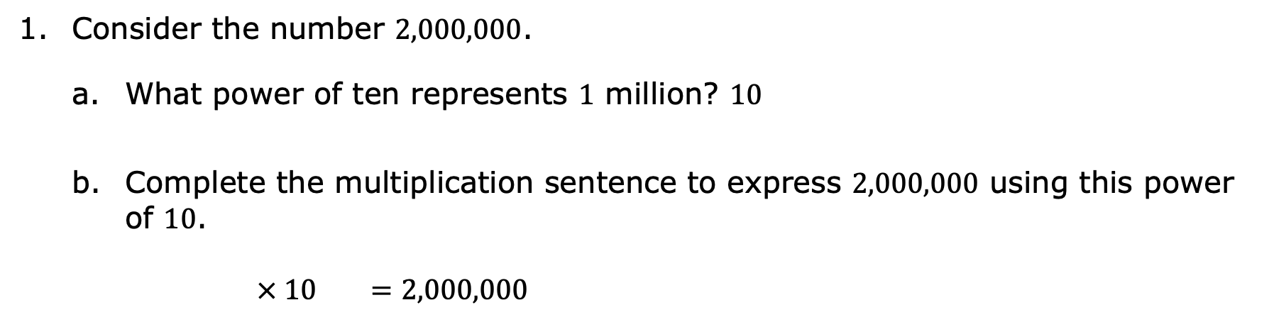
3.2.3 Guided Instruction: Writing Large Numbers in Scientific Notation
Consider the number $2,000,000$.
What power of ten represents $1$ million? $10$
Complete the multiplication sentence to express $2,000,000$ using this power of $10$.
$× 10 =2,000,000$
Scientific notation is a method of writing very large or very small numbers using exponents in which a number is expressed as the product of a power of $10$ and a number that is at least $1$ and less than $10$.
volume 1, pg. 88

Slide 13
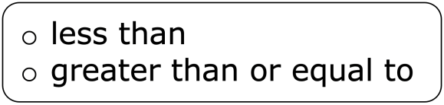
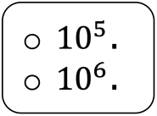
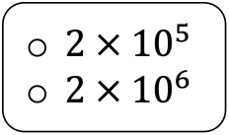
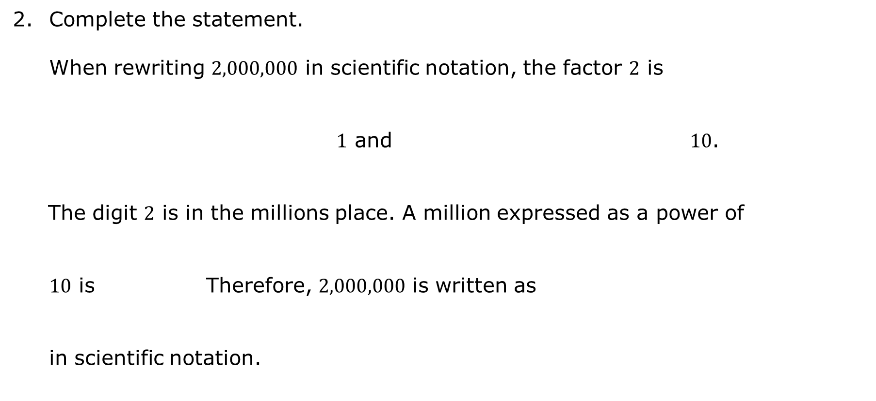
Complete the statement.
When rewriting $2,000,000$ in scientific notation, the factor $2$ is $1$ and $10$. The digit $2$ is in the millions place. A million expressed as a power of
$10$ is Therefore, $2,000,000$ is written as
in scientific notation.
volume 1, pg. 88

Slide 14
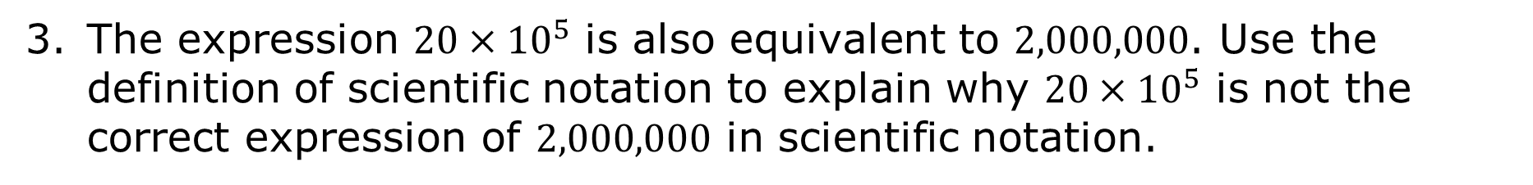
The expression $20×{10}^{5}$ is also equivalent to $2,000,000$. Use the definition of scientific notation to explain why $20×{10}^{5}$ is not the correct expression of $2,000,000$ in scientific notation.
volume 1, pg. 88

Slide 15
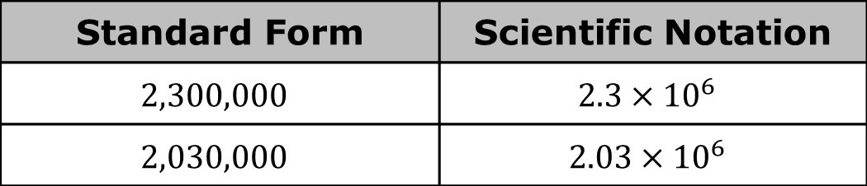
Consider the standard form and scientific notation of the numbers shown in the table. Describe the similarities and differences between the values expressed in scientific notation.
Standard Form | Scientific Notation
$$2,300,000$$ | $$2.3×{10}^{6}$$
$$2,030,000$$ | $$2.03×{10}^{6}$$
Similarities | Differences
volume 1, pg. 88

Slide 16
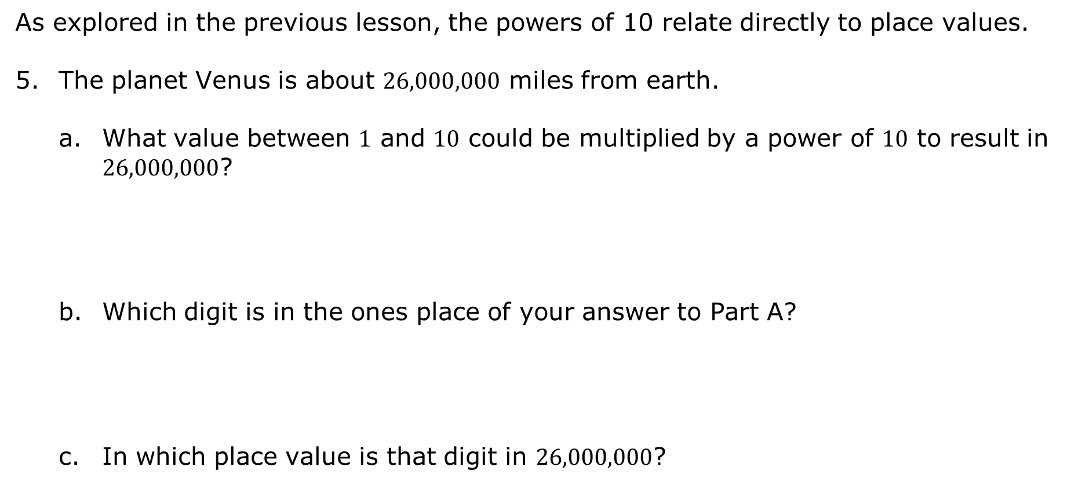
As explored in the previous lesson, the powers of 10 relate directly to place values.
The planet Venus is about $26,000,000$ miles from earth.
What value between $1$ and $10$ could be multiplied by a power of $10$ to result in $26,000,000$?
Which digit is in the ones place of your answer to Part A?
In which place value is that digit in $26,000,000$?
volume 1, pg. 89

Slide 17
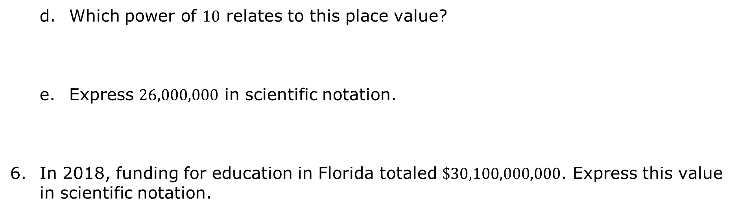
Which power of $10$ relates to this place value?
Express $26,000,000$ in scientific notation.
In 2018, funding for education in Florida totaled $\$30,100,000,000$. Express this value in scientific notation.
volume 1, pg. 89

Slide 18

Guided Practice
volume 1, pg. 89

Slide 19

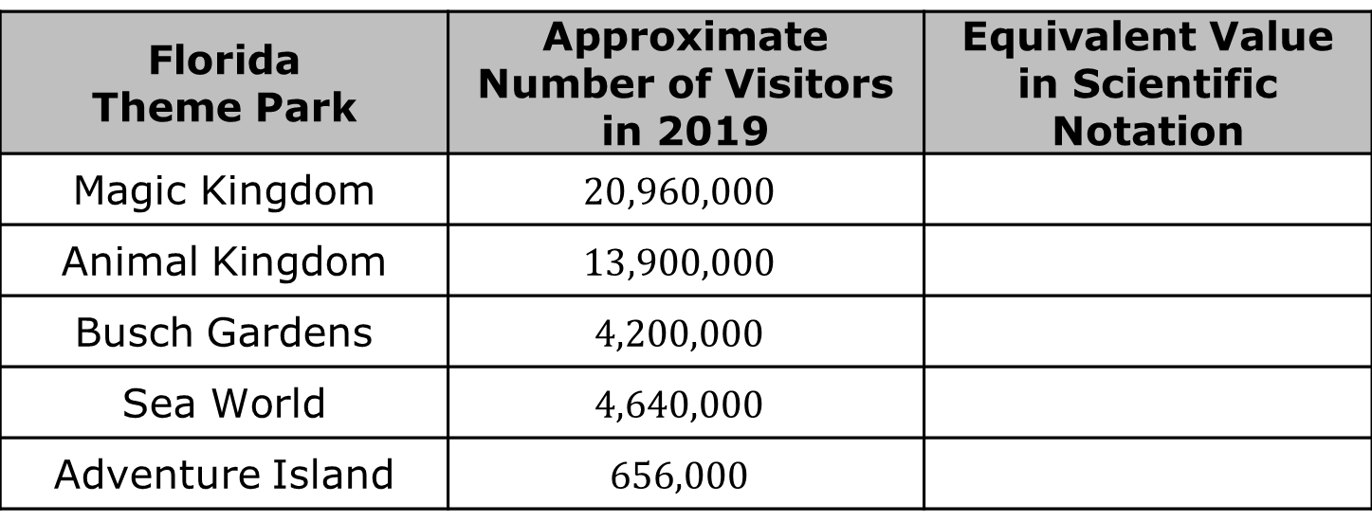
3.2.4 Guided Practice: Writing Large Numbers in Scientific Notation
The table shows the number of visitors to several amusement parks in Florida in 2019. Express each value in scientific notation.
Florida Theme Park | Approximate Number of Visitors in 2019 | Equivalent Value in Scientific Notation
Magic Kingdom | $$20,960,000$$
Animal Kingdom | $$13,900,000$$
Busch Gardens | $$4,200,000$$
Sea World | $$4,640,000$$
Adventure Island | $$656,000$$
volume 1, pg. 89

Slide 20

Collaboration
volume 1, pg. 90

Slide 21
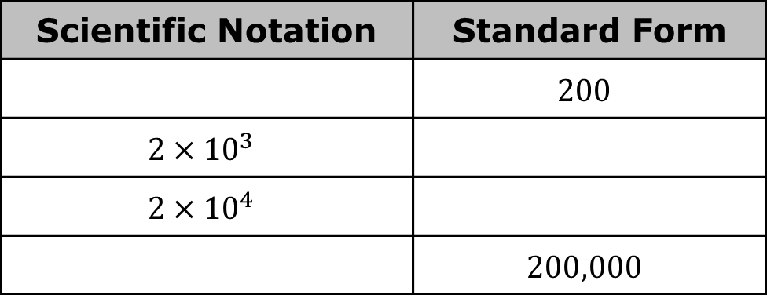
3.2.5 Collaboration: Comparing Large Numbers Written in Scientific Notation
Work with your partner to complete the following.
Complete the table.
Scientific Notation | Standard Form
 | $$200$$
$${2×10}^{3}$$
$${2×10}^{4}$$
 | $$200,000$$
volume 1, pg. 90

Slide 22
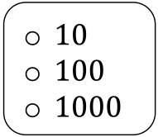
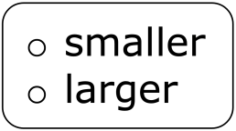
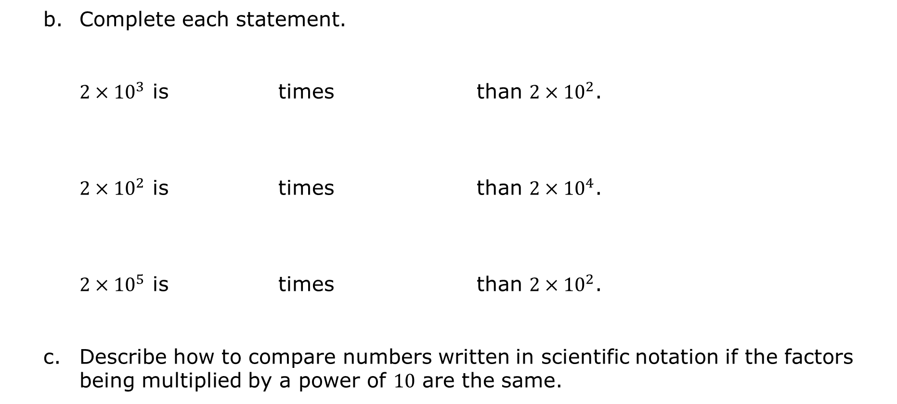
Complete each statement. $2×{10}^{3}$ is times than $2×{10}^{2}$. $2×{10}^{2}$ is times than $2×{10}^{4}$. $2×{10}^{5}$ is times than $2×{10}^{2}$.
Describe how to compare numbers written in scientific notation if the factors being multiplied by a power of $10$ are the same.
volume 1, pg. 90

Slide 23

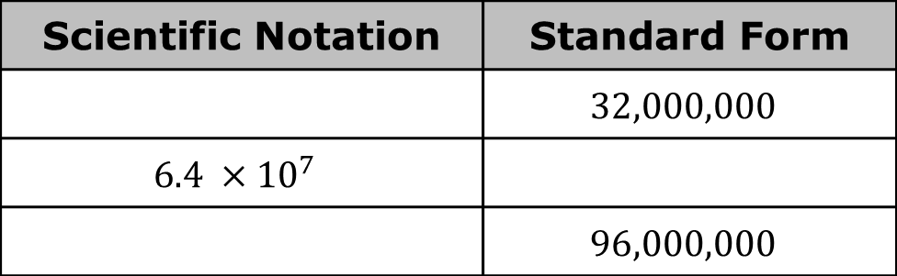
Complete the table.
How many times larger is $6.4 ×{10}^{7}$ than $3.2 ×{10}^{7}$?
How many times smaller is $3.2 ×{10}^{7}$ than $9.6 ×{10}^{7}$?
Describe how to compare numbers written in scientific notation if the powers of 10 are the same.
Scientific Notation | Standard Form
 | $$32,000,000$$
$${6.4 ×10}^{7}$$
 | $$96,000,000$$
volume 1, pg. 90

Slide 24

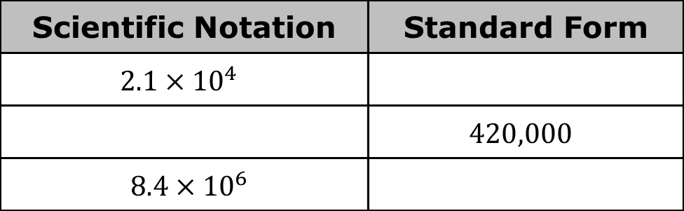
Complete the table.
How many times larger is $4.2$ than $2.1$?
How many times larger is ${10}^{5}$ than ${10}^{4}$?
How many times larger is $4.2×{10}^{5}$ than $2.1×{10}^{4}$?
$× = __________$times larger
Scientific Notation | Standard Form
$2.1×{10}^{4}$
 | $420,000$
$8.4×{10}^{6}$
volume 1, pg. 90

Slide 25
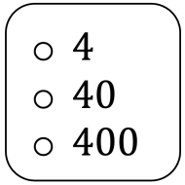
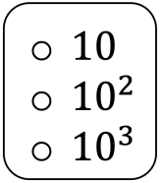
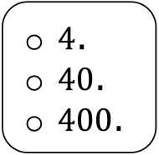
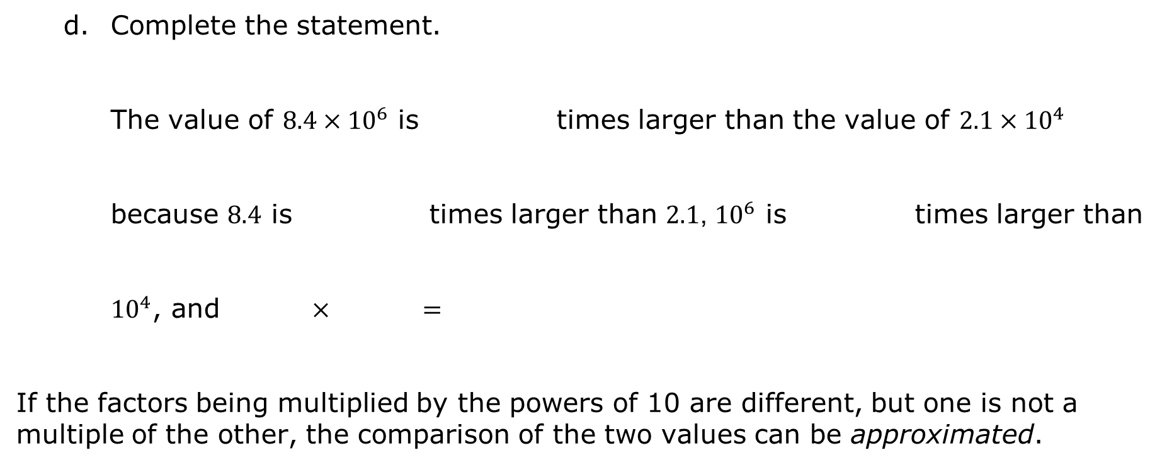
Complete the statement. The value of $8.4×{10}^{6}$ is times larger than the value of $2.1×{10}^{4}$ because $8.4$ is times larger than $2.1$, ${10}^{6}$ is times larger than ${10}^{4}$, and $×$ $=$
If the factors being multiplied by the powers of 10 are different, but one is not a multiple of the other, the comparison of the two values can be approximated.
volume 1, pg. 91

Slide 26
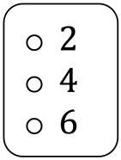
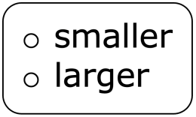
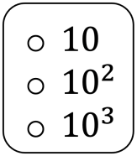
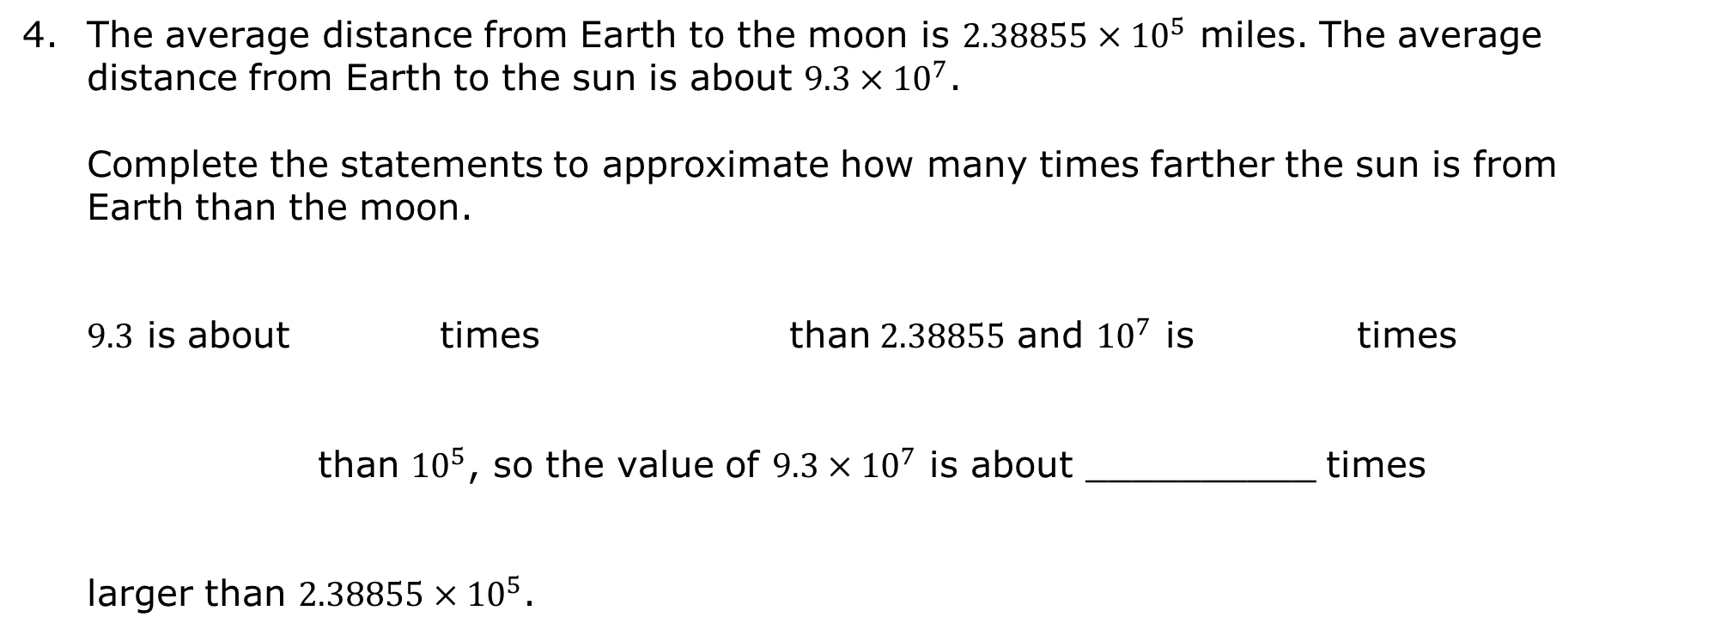
The average distance from Earth to the moon is $2.38855×{10}^{5}$ miles. The average distance from Earth to the sun is about $9.3×{10}^{7}$. Complete the statements to approximate how many times farther the sun is from Earth than the moon.
$9.3$ is about times than$2.38855$ and ${10}^{7}$ is times than ${10}^{5}$, so the value of $9.3×{10}^{7}$ is about __________ times larger than $2.38855×{10}^{5}$.
volume 1, pg. 91

Slide 27

Your Turn
volume 1, pg. 91

Slide 28
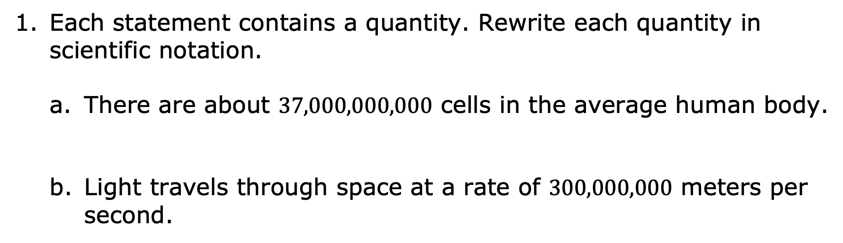
3.2.6 Your Turn!
Each statement contains a quantity. Rewrite each quantity in scientific notation.
There are about $37,000,000,000$ cells in the average human body.
Light travels through space at a rate of $300,000,000$ meters per second.
volume 1, pg. 91

Slide 29
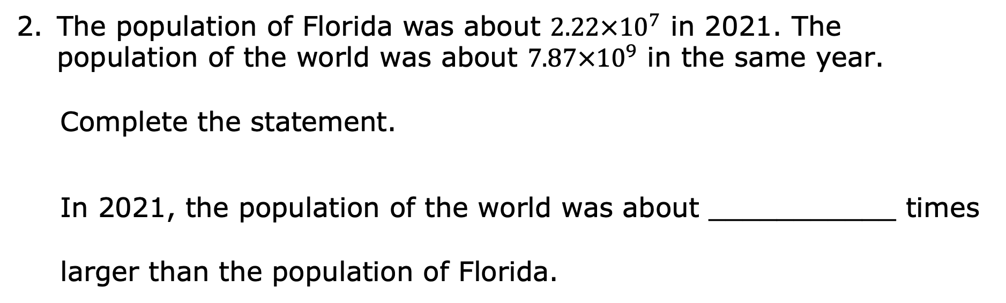
The population of Florida was about $2.22×{10}^{7}$ in 2021. The population of the world was about $7.87×{10}^{9}$ in the same year.
Complete the statement.
In 2021, the population of the world was about ___________ times larger than the population of Florida.
volume 1, pg. 91

Slide 30

Wrap-Up
volume 1, pg. 92

Slide 31
3.2.7 Wrap-Up: Reflection
Draw an X on each line to indicate where your current learning is related to each target.
I can express large numbers using scientific notation.
I can determine how many times larger or smaller a number is compared to another expressed in scientific notation.
I need help. I can’t get started. | I’m getting there, but I need more practice. | I understand this and I feel confident.
I need help. I can’t get started. | I’m getting there, but I need more practice. | I understand this and I feel confident.
volume 1, pg. 92

